Slide 1
Memory Allocation Algorithms
() (a) First fit
Scan from the beginning and find the first hole that is big enough.
Next fit
Similar to first fit except that search starts from where it left off.
Best fit
Search the entire list and take the smallest hole that is adequate.
Worst fit
Take the largest hole.

Slide 2
Memory Allocation Algorithms
(e) Quick fit
Maintain separate lists of holes for commonly used sizes. Sorted by hole size.
Finding a hole is fast. What about merging holes? May go through the entire list.
4K
8K
12K
16K
20K

Slide 3
Memory Management with buddy System
Maintain a list of free blocks of size 2,⁰ up to the size of memory.
1
2
k
2, 2, , …, 2, …, bytes,
Example: 1 MB memory, 21 lists needed from 1 byte to 1 MB. Process A requests 70K, need 128K hole. 1MB is split into two 512K blocks (buddies).
Allocation: If the needed size is available, done.
If not, look at the next large size (double size). If available, split it into two blocks and use one.
If not available, look at next large size . . . . At most log N steps for N bytes memory.

Slide 4
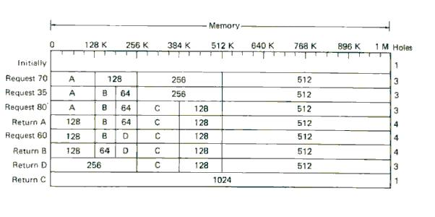
Memory Management with buddy System

Slide 5
Memory Management with buddy System
Advantage:
It is fast because when a block size of 2k bytes is returned only the 2k list has to be searched to see if a merge is possible.
Drawback:
Low memory utilization (All memory requests have to be rounded up to a power of two).
Large internal fragmentation (wasted memory internal to the allocated segments).
External fragmentation(checker boarding): wasted holes between segments.

Slide 6
Virtual Memory-the history
Keep multiple parts of programs in memory
Swapping is too slow (100 Mbytes/sec disk transfer rate=>10 sec to swap out a 1 Gbyte program)
Overlays-programmer breaks program into pieces which are swapped in by overlay manager
Ancient idea-not really done
Too hard to do-programmer has to break up program
Tanenbaum, Modern Operating Systems 3 e, (c) 2008 Prentice-Hall, Inc. All rights reserved. 0-13-6006639

Slide 7
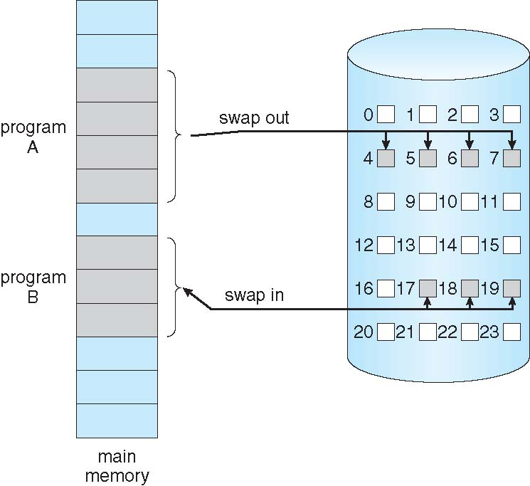
Transfer of a Paged Memory to Contiguous Disk Space

Slide 8
Demand Paging for Virtual Memory
Bring a page into memory ONLY when it is needed
Less I/O needed
Less memory needed
Faster response
More users supported
Check a page table entry when a page is needed
not-in-memory ⇒ bring to memory

Slide 9
Valid-Invalid Bit
With each page table entry a valid–invalid bit is associated (v ⇒ in-memory, i ⇒ not-in-memory)
Initially valid–invalid bit is set to i on all entries
Not in memory ⇒ page fault
Frame #
valid-invalid bit
v
v
v
v
i
….
i
i
page table

Slide 10
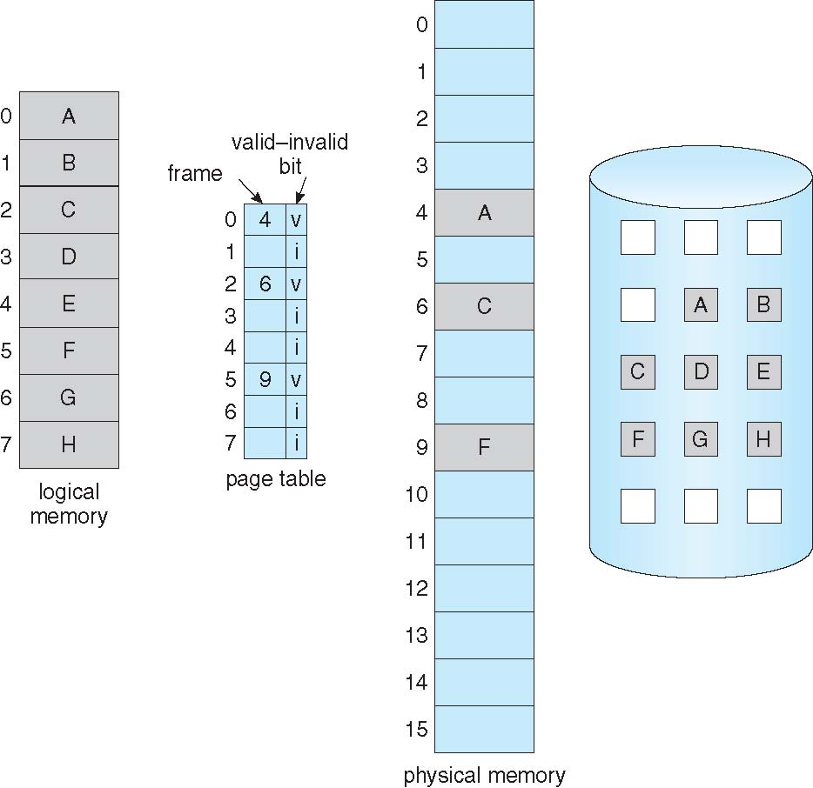
Page Table When Some Pages Are Not in Main Memory

Slide 11
Handling a Page Fault
Get an empty physical frame
Swap page from the disk into frame
Reset the page table
Set validation bit = v
Restart the instruction that caused the page fault

Slide 12
Page Fault (Cont.)
Restart instruction
Special handling
block move
Auto increment/decrement

Slide 13
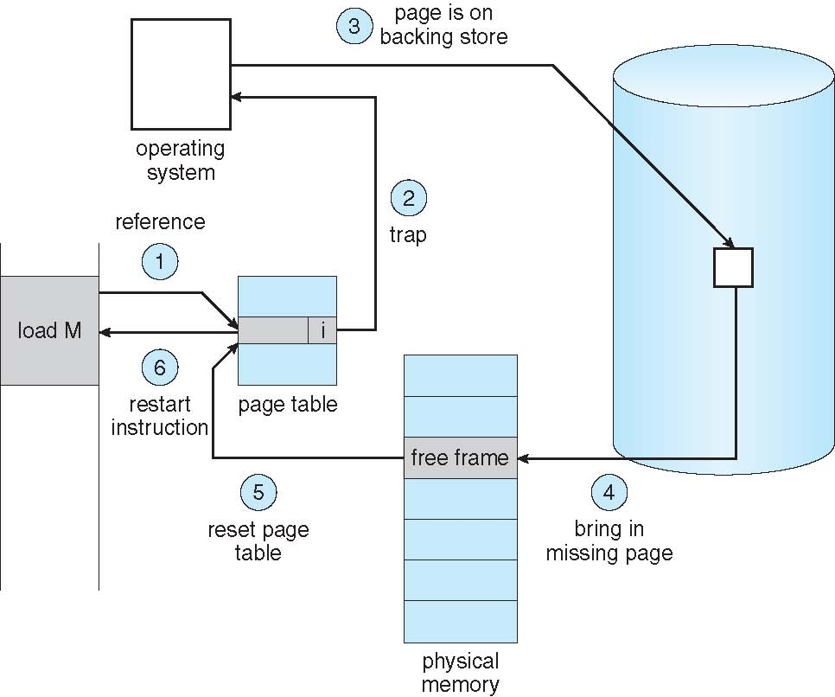
Steps in Handling a Page Fault

Slide 14
Performance of Demand Paging
Page Fault Rate 0 ≤ p ≤ 1.0
if p = 0, no page faults
if p = 1, every reference is a fault
Effective Access Time (EAT)
EAT = (1 – p) x memory access
+ p (page fault overhead
+ swap page out
+ swap page in
+ restart overhead
)

Slide 15
Demand Paging Performance Example
Memory access time = 200 nanoseconds
Average page-fault service time = 8 milliseconds
EAT = (1 – p) x 200 + p (8 milliseconds)
= (1 – p x 200 + p x 8,000,000
= 200 + p x 7,999,800
If one access out of 1,000 causes a page fault, then
EAT = 8.2 microseconds.
This is a slowdown by a factor of 40!!

Slide 16
Other Benefits
Virtual memory allows other benefits
- Shared pages
- Copy-on-Write during process creation
- Memory-Mapped Files

Slide 17
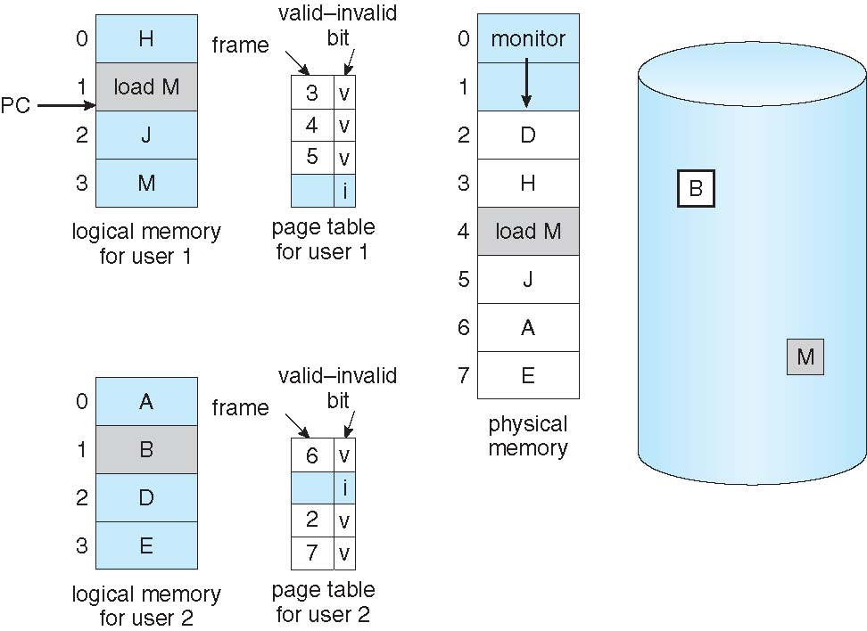
Need For Page Replacement

Slide 18
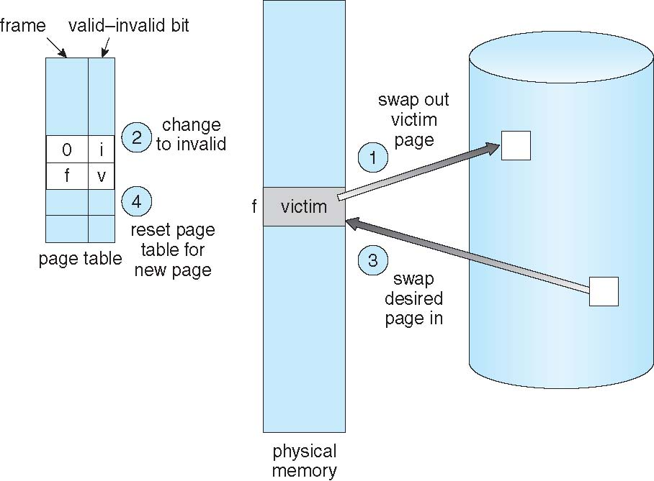
Page Replacement

Slide 19
Page Replacement Algorithms
Page fault: the page to be accessed is not in memory (a trap to CPU).
What O.S. to do when a page fault occurs
•Bring a page into memory
•Update page table
•Continue execution of the process
What to do when memory is full:
•Remove one page already in memory.
Page replacement:
When a page fault occurs, O.S. removes a page from memory to make a room for the page that has to be brought in.

Slide 20
Page Replacement Algorithms
Page fault forces choice
which page must be removed
make room for incoming page
Modified page must first be saved
unmodified just overwritten
Better not to choose an often used page
will probably need to be brought back in soon
Why virtual memory can be successful: because of locality of reference. The memory reference tends to be local. Access the nearby locations, not crossover the entire memory space.
4

Slide 21
Page Replacement Algorithms
Random algorithm (pick up any page at random)
Optimal page replacement algorithm
Not recently used page replacement
First-In, First-Out page replacement
Second chance page replacement
Clock page replacement
Least recently used page replacement
Tanenbaum, Modern Operating Systems 3 e, (c) 2008 Prentice-Hall, Inc. All rights reserved. 0-13-6006639

Slide 22
Optimal Page Replacement Algorithm
Replace the page needed at the farthest point in future (Select for replacement that page for which the time to the next reference is the longest)
Optimal but unrealizable
Results in the fewest number of page faults
Impossible to implement
Good for comparison
Estimate by …
logging page use on previous runs of process, although this is impractical

Slide 23
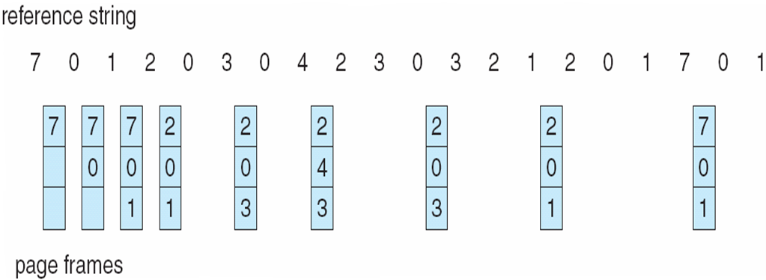
Optimal Page Replacement

Slide 24
Not Recently Used Page Replacement Algorithm
Based on locality of reference. Use the past to predict the future.
Need hardware support:
Two bits associated with each page:
R: reference bit. Set by hardware on any memory read/write to the page.
M: modified bit. Set by hardware when a page is written.
O.S. can reset these two bits in software.

Slide 25
Not Recently Used Page Replacement Algorithm
Algorithm:
When a process is started, R and M bits for all its pages are set to 0.
On each clock tick interrupt, clear the R bit.
When a page fault occurs, choose a page from the lowest numbered nonempty class:
Class | R | M
0 | 0 | 0 | not referenced, not modified
1 | 0 | 1 | not referenced, modified
2 | 1 | 0 | referenced, not modified
3 | 1 | 1 | referenced, modified
Easy to implement. Performance is okay. No history of how long the page is used.

Slide 26
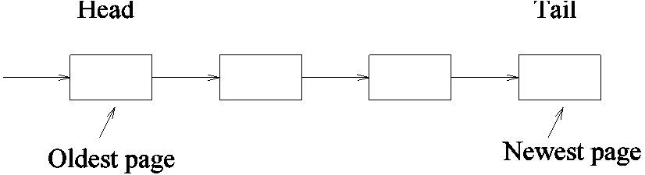
FIFO Page Replacement Algorithm
Maintain a linked list of all pages in order they came into memory
When page fault occurs, page at beginning of list replaced
Disadvantage
may remove a heavily used as a page in memory the longest may be often used.
Solution:
Inspect R and M bits of all pages. Remove the oldest page with R = 0.

Slide 27
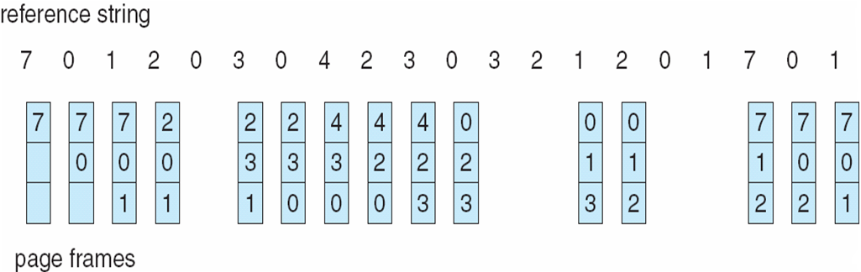
FIFO Page Replacement

Slide 28
First-In-First-Out (FIFO) Algorithm
Reference string: 1, 2, 3, 4, 1, 2, 5, 1, 2, 3, 4, 5
3 frames (3 pages can be in memory at a time per process). Maintain a queue and select based on FIFO order.
4 frames
Belady’s Anomaly: more frames ⇒ more page faults
1
1
4
5
2
2
1
3
9 page faults
3
3
2
4
1
1
5
4
2
2
1
5
10 page faults
3
3
2
4
4
3

Slide 29
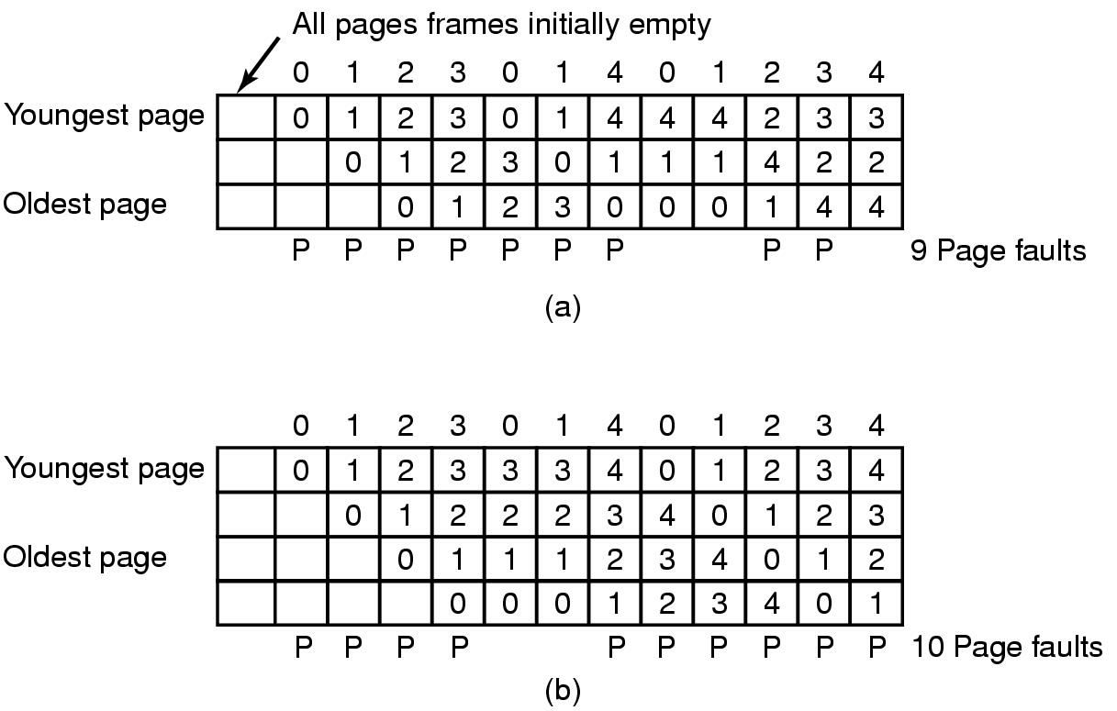
Belady's Anomaly
FIFO with 3 page frames
FIFO with 4 page frames
P's show which page references show page faults

Slide 30
Least Recently Used (LRU)
Assume pages used recently will be used again soon
throw out page that has been unused for longest time
Must keep a linked list of pages
most recently used at front, least at rear
update this list every memory reference !!
Alternatively keep counter in each page table entry
choose page with lowest value counter
periodically zero the counter
5

Slide 31
Least Recently Used (LRU)
Replace the page in memory that has not been referenced for the longest time.
Performance close to optimal algorithm
Implementation is not cheap. Either requires special hardware or approximate software simulation.

Slide 32
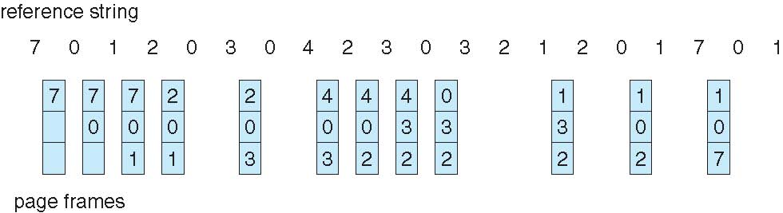
LRU Page Replacement

Slide 33
LRU Page Replacement
Counter implementation
Every page entry has a counter; every time page is referenced through this entry, copy the clock into the counter
When a page needs to be changed, look at the counters to determine which are to change

Slide 34
LRU Algorithm Implementation
Stack implementation – keep a stack of page numbers in a double link form:
Page referenced:
move it to the top
requires 6 pointers to be changed
No search for replacement

Slide 35
Design Issues for Paging System
Aiming at good performance.
Working set: the set of pages a process is currently using
Thrashing: a program causes page fault every few instructions
How to control thrashing:
•Keep the entire working set in memory
•Page fault frequency allocation algorithm (PFF)
In most page replacement algorithms, we can choose a certain number of page frames for each process to keep a certain page fault rate. Dynamically allocate page frames to each process.

Slide 36
Segmentation
A compiler has many tables that are built up as compilation proceeds, possibly including:
The source text being saved for the printed listing (on batch systems).
The symbol table – the names and attributes of variables.
The table containing integer, floating-point constants used.
The parse tree, the syntactic analysis of the program.
The stack used for procedure calls within the compiler.
Tanenbaum, Modern Operating Systems 3 e, (c) 2008 Prentice-Hall, Inc. All rights reserved. 0-13-6006639

Slide 37
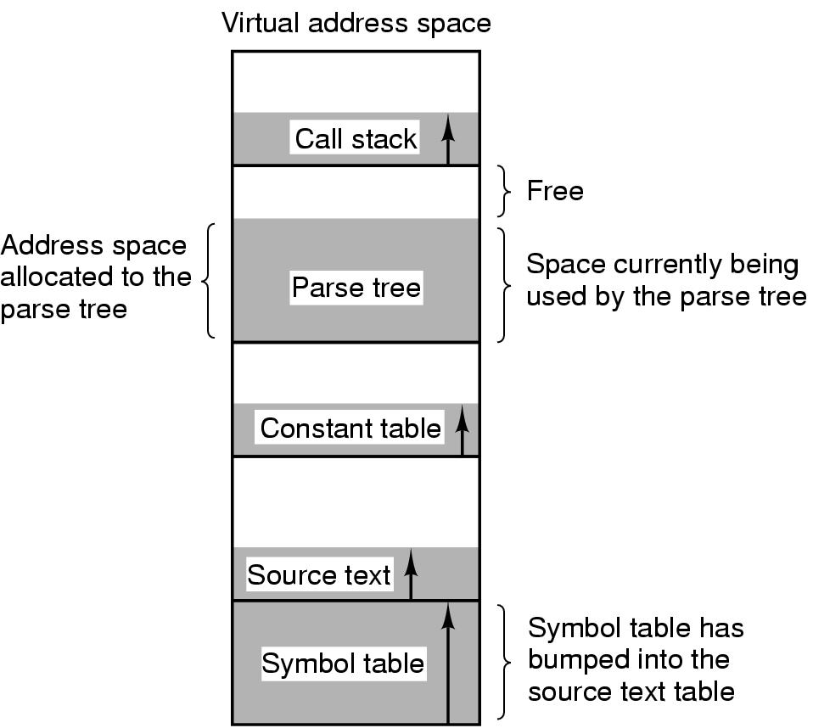
Segmentation
Figure 3-31. In a one-dimensional address space with growing tables, one table may bump into another.
Tanenbaum, Modern Operating Systems 3 e, (c) 2008 Prentice-Hall, Inc. All rights reserved. 0-13-6006639

Slide 38
Segmentation
Segmentation system
idea: access files using memory address
two dimension address space: segment and offset
divide logical address space into segments. Each segment is a logical unit, such as data, code,
and file.
segment size is variable, and often large
Segment table shows the mapping between logical addresses and physical addresses.

Slide 39
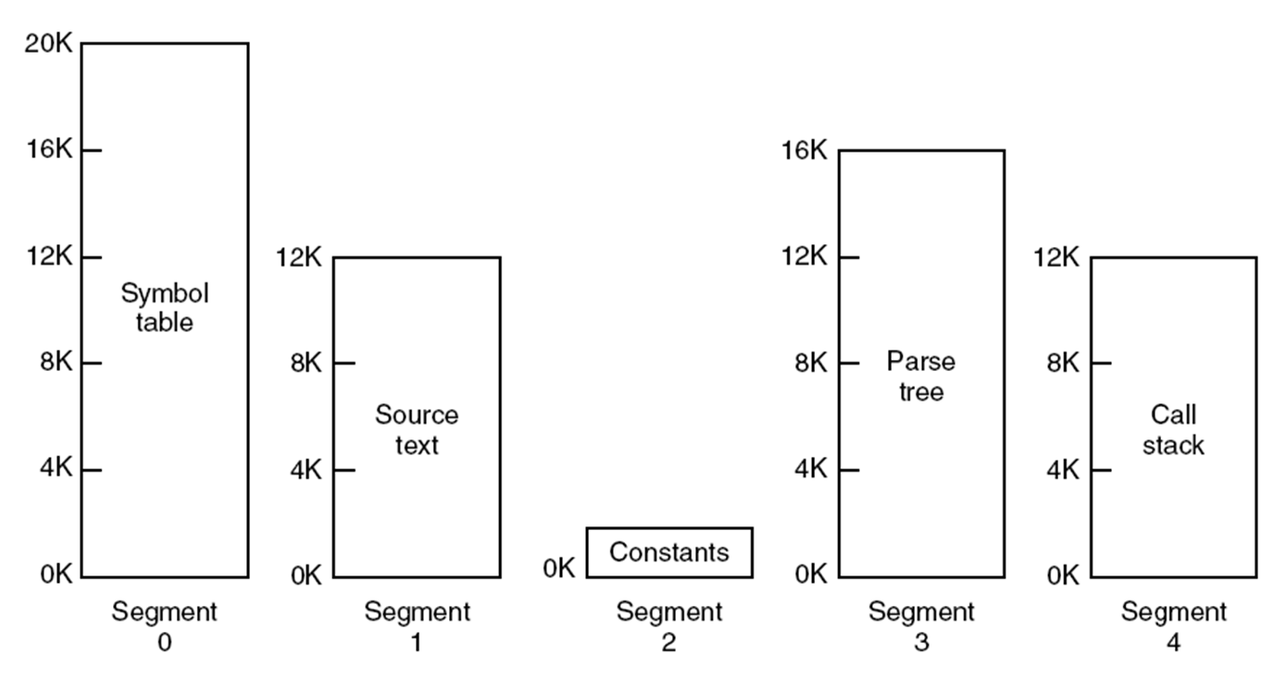
Segmentation
Figure 3-32. A segmented memory allows each table to grow or shrink independently of the other tables.
Tanenbaum, Modern Operating Systems 3 e, (c) 2008 Prentice-Hall, Inc. All rights reserved. 0-13-6006639

Slide 40
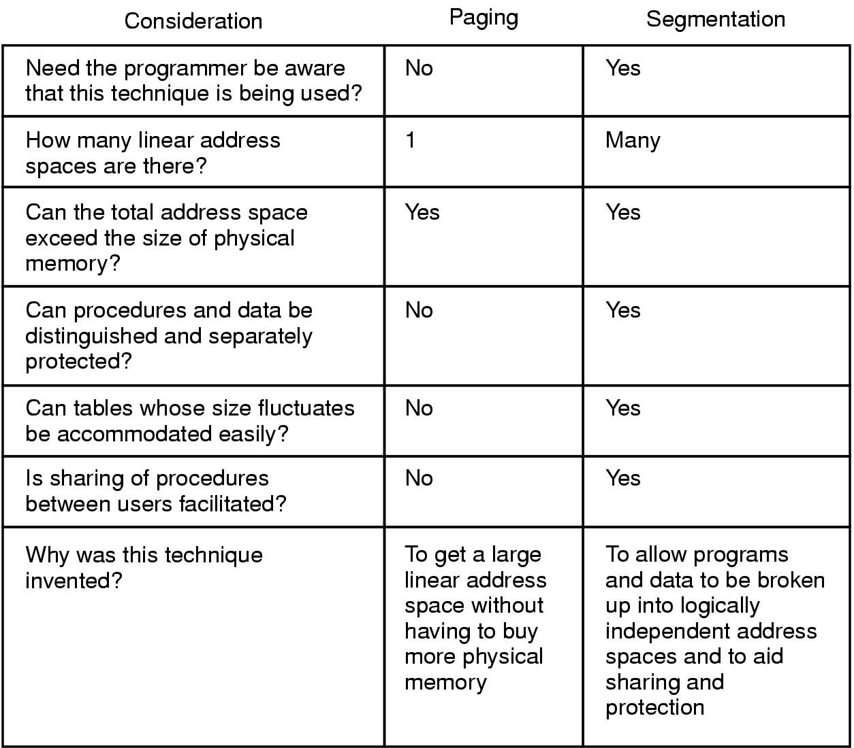
Implementation of Pure Segmentation
Figure 3-33. Comparison of paging and segmentation.
Tanenbaum, Modern Operating Systems 3 e, (c) 2008 Prentice-Hall, Inc. All rights reserved. 0-13-6006639

Slide 41
Difference between Paging And Segmentation
Paging | Segmentation
A page is a contiguous range of memory addresses which is mapped to physical memory. | A segment is an independent address space. Each segment has addresses in a range from 0 to maximum value.
It has only one linear address space. | It has many address spaces.
Programmer does not know that it is implemented | Programmer knows that it is implemented.
Procedures and data cannot be separated | Procedures and data can be separated
Procedures cannot be shared between users | Procedures can be shared between users
Procedures and data cannot be protected separately | Procedures and data can be protected separately
Compilation cannot be done separately | Compilation can be done separately
A page is a physical unit | A segment is a logical unit
A page is of fixed size | A segment is of arbitrary size.

